Slide 1
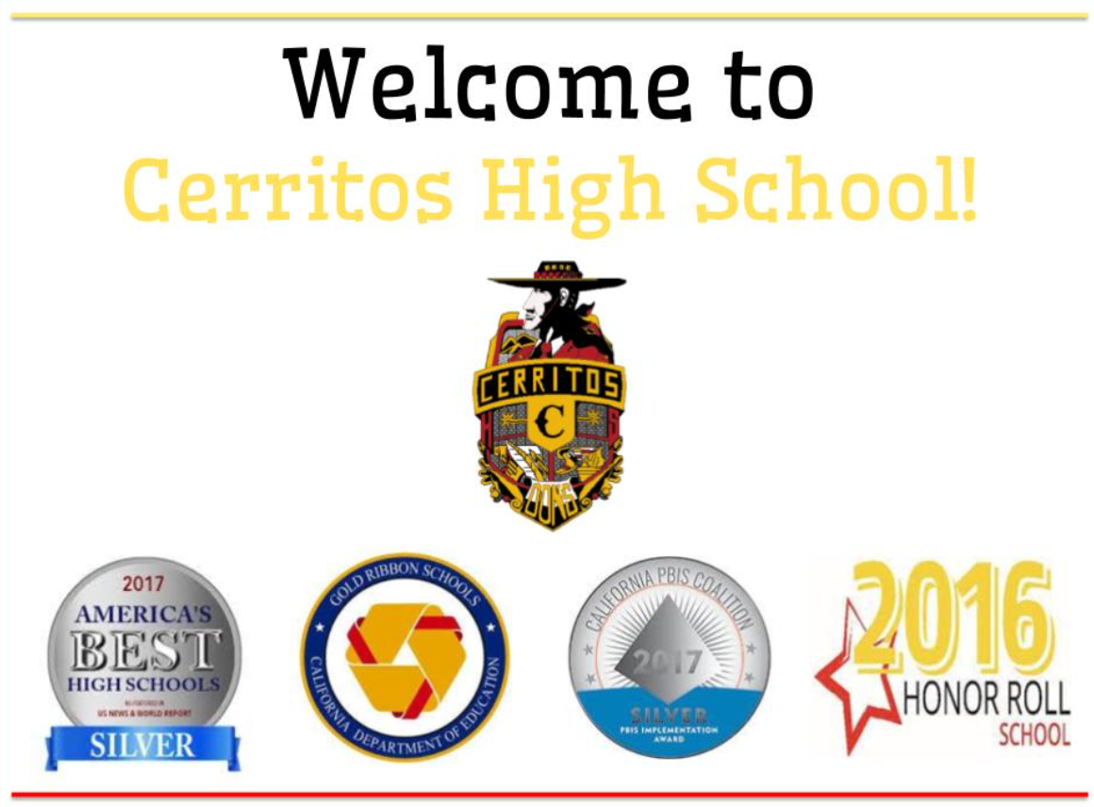

HS-PBIS Symposium 2018
Successful High School PBIS Implementation:
HSPBIS Implementers Panel Discussion
Pat Walker
Megan Harding
Diane Middleton

Slide 2

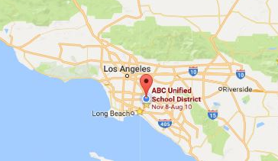
ABC USD: School Transformation Grant (2014)
ABC Unified School District (Artesia- Cerritos-Lakewood-Hawaiian Gardens, CA) -29 Schools
  Identified in USA Today as most diverse area in nation
  19 elementary Schools
  5 middle schools
  5 high schools
  Adult School
  4 EC programs
Notes:
Data to tell stories…moving toward building data decision system
Using the they do, side by side, we do model
Exemplar with CALTAC PBIS
Federal Grant

Slide 3
ABC USD Profile Ethnic Breakdown
Notes:
Of 29 sites, 15 have students populations where 50% or more have Free and Reduced Lunch and parents did not graduate from HS.
About 1/3 of schools the percentage is 80% or higher.
Gangs, languages, violence up tick since election

Slide 4
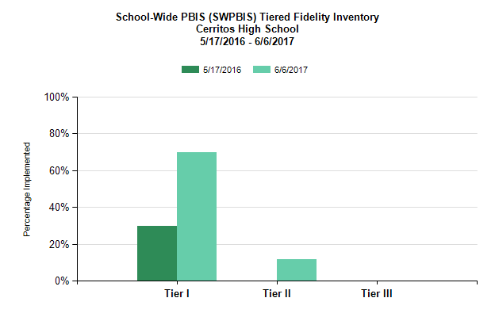
Telling Our Story with DATA

Slide 5
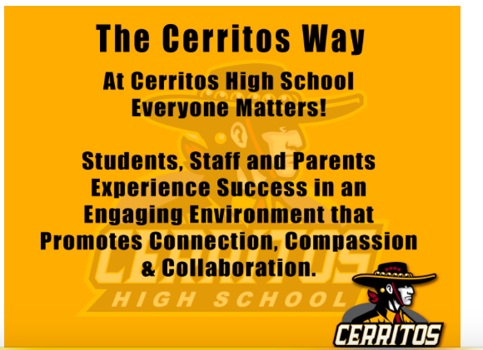
Staff, students, and parents were surveyed about what is “The Cerritos Way”
Notes:
Link Videos
Visuals posters
Policies Cell Phone, STRIVE, Academic Integrity
The Cerritos Way- Instruction

Slide 6

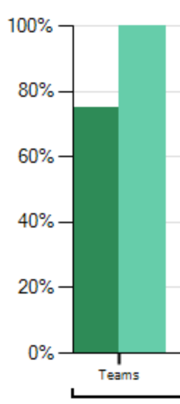

"The Cerritos Way" Cell Phone Policy Survey
Common Areas Survey
Behavior Expectations
Survey
Tardy Policy Survey
Tiered Fidelity Inventory
Tier I TEAMS
Academic Integrity
Policy Survey
Notes:
Picture of team
Departments
Be honest- and frank

Slide 7
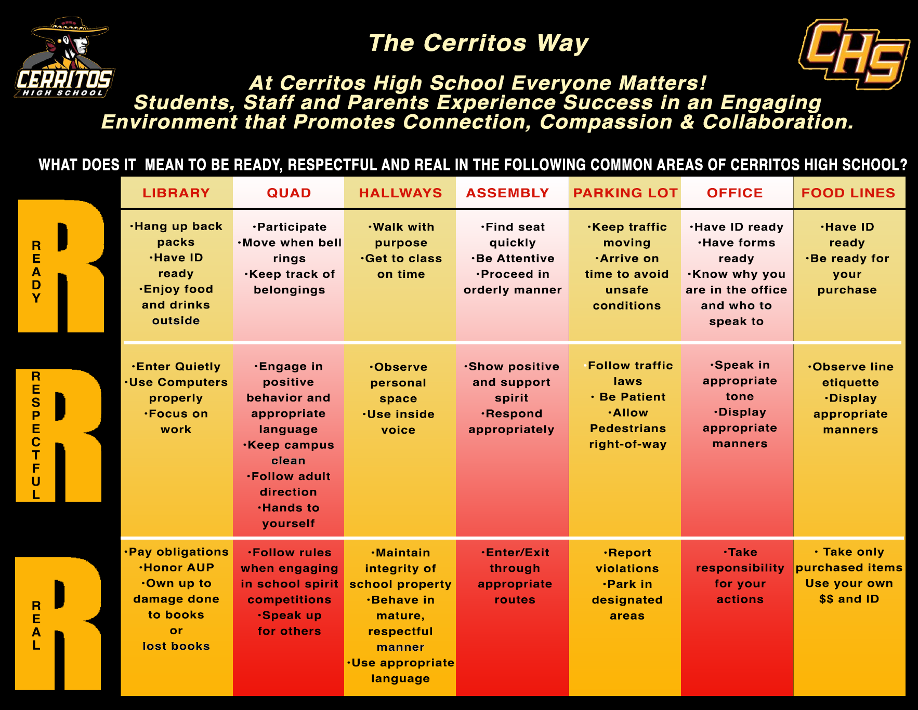
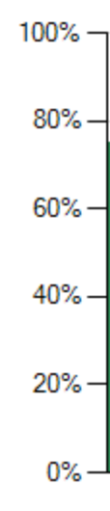
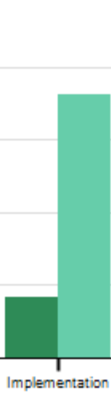
Tiered Fidelity Inventory
IMPLEMENTATION
Tier I
Notes:
Student Voice where and how

Slide 8
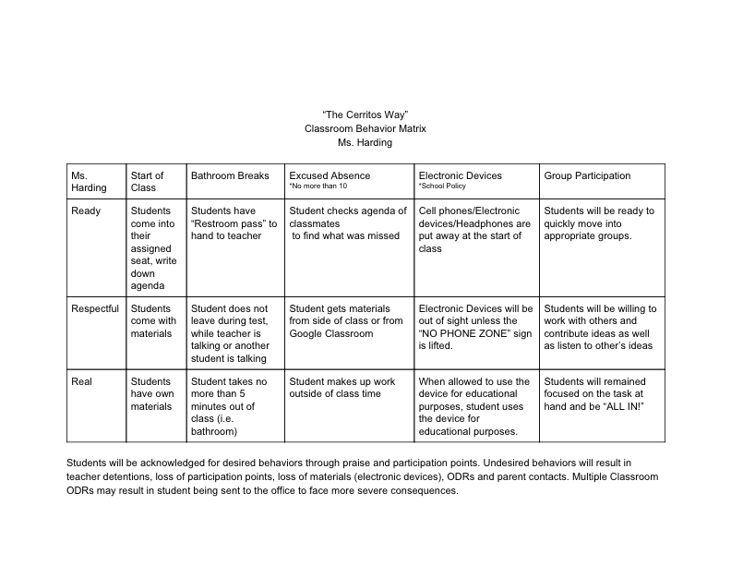
Classroom Matrix
“ The Cerritos Way” and the behavior expectations can be unique in each classroom and specific to their personal teaching styles and goals.

Slide 9


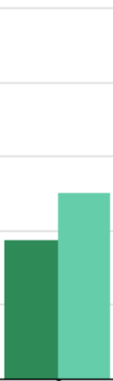
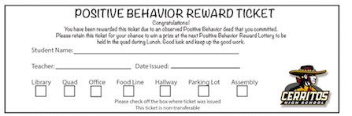
Tiered Fidelity Inventory
EVALUATION
Tier I
“The Cerritos Way” Raffle Student Acknowledgment System
Notes:
Using Data for decision making
Outcome data
ODR- School Climate- NAMI on campus
California Safe School

Slide 10
The Cerritos Way
Office Discipline Referral
* Teachers can use as accountability
*Aligned with AERIES
Notes:
Discipline Process ? What kids can benefit from a self management system
ODR/Nomination Form Working with Special Ed
How is this being set up Hour Power Programs
SST –
Check in Check Out

Slide 11
Students are referred by their counselor after staff concerns are documented on ODRs.
Students are assigned to an adult staff member and for intervention designed to self manage.
Notes:
Picture of Tier II team

Slide 12
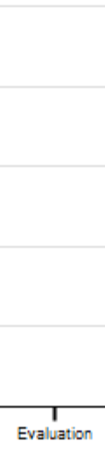
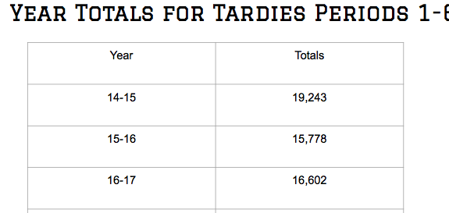
Tiered Fidelity Inventory
EVALUATION
Tier I

Slide 13
PBIS- “The Cerritos Way” a part of the WASC Action Plans
Action Plan 6
Fully Implement PBIS- Positive Behavior Interventions and Support
Rationale:
Self Study Findings, data analysis, Needs assessment survey
Growth Target:
By 2021, 80% of the staff and the students will be be aware of current behavior expectations
Ready, Respect, Real

Slide 14
ABC
Schools Implementing
PBIS
ABC USD
Scaling UP and Capacity Building Model
EXEMPLAR COHORT: 2014-2015
Trainers: CalTAC-PBIS
Bragg ES, Juarez ES, Palms ES, Furgeson ES, Willow ES, Carmenita MS, Ross MS
SIDE-BY SIDE COHORT:
2015-16
Tier III
Trainers: CalTAC-PBIS/District
Aloha
Carver
Hawaiian
Kennedy
Leal
Wittmann
Fedde MS
Tetzlaff MS
Cerritos HS
DISTRICT
COHORT:
2016-17
Tier II
Trainers: District
Elliott ES
Cerritos ES
Gonzalves ES
Melbourne
Niemes
Nixon
Haskell MS
DISTRICT
COHORT:
2016-17
Tier II
Trainers: District
Burbank
Stowers
Gahr HS
Notes:
Gradual Release of Responsibility – Exemplar – I DO/ Side by Side
Leadership Academy & Shadow the Exemplar ABC/CalTAC/District Alone with consultation/
Scale up in District Coaches: 1 FTE + 2 halfs (Michelle) +2 HS only site coaches
CHS/GAHR…….3 more HS not trained as of yet…will come back to that later….5 year grant came when they felt ready
CHS volunteered first, all schools came to it on own time

Slide 15
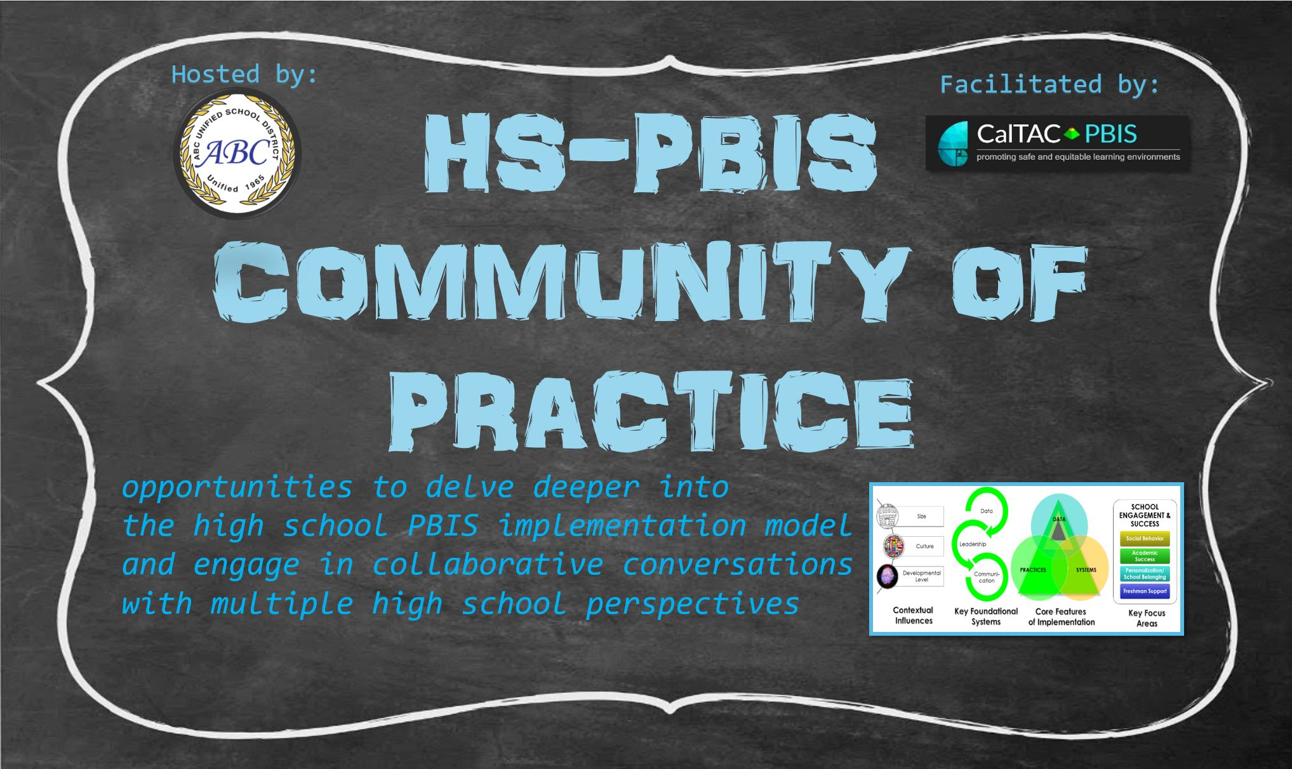

Serving Up: Collaborative Conversations
& Opportunities for Exploration
2016-17
SCHOOL CLIMATE
STUDENT VOICE
IMPLICIT BIAS
TEAM COMPOSITION
CLASSROOM PRACTICES
CYCLES OF ESCALATION
DATA-BASED DECISION MAKING
2017-18
BUY-IN
LEADING BY CONVENING
RESTORATIVE PRACTICES
SELF-DETERMINATION THEORY
PARTNERSHIPS
DE-BRIEFING THE HS PBIS SYMPOSIUM
Notes:
Elementary vs. High School Contexts (size, students, silos)
Need to differentiate for high schools
Engineer the environment for structured exploration
no pressure, just exploration and collaboration through
Community of Practice model

